Slide 1

Building Blocks of UML
Object Oriented Design and Analysis

Slide 2
OOAD with UML
Building a house
Design and layout
Blueprint
Actual construction
Building software
OOAD
UML
Coding

Slide 3
A conceptual model of the UML
To understand the UML, you need to form a conceptual model of the language, and this requires learning three major elements:
The UML’s basic building blocks.
The rules that dictate how these building blocks put together.
Some mechanisms that apply throughout the UML.

Slide 4
Building Blocks of UML
Things – abstractions that are first class citizen in a model
Relationships - tie things together
Diagrams - group interesting collections of things

Slide 5
Things in the UML
There are four kinds of things in the UML:
Structural things Behavioral things Grouping things Annotational things

Slide 6
Structural Things
Static part of a model, representing elements that are either conceptual or physical
Classes
Interfaces
Collaborations
Use cases
Active classes
Components
Nodes

Slide 7
class
•
a class is a description of a set of objects that share the same attributes, operations, relationships, and semantics
A class implements one or more interfaces.
interface
a collection of operations that specify a service of a class or component
describes the externally visible behavior of that element
defines a set of operation specifications but never a set of operation implementations
attached to class or component that realizes the interface
Collaboration
defines an interaction and is a society of roles and other elements that work together to provide some cooperative behavior
Collaborations have structural, as well as behavioral dimensions
A given class may participate in several collaborations
therefore represent the implementation of patterns that make up a system
•
•

Slide 8

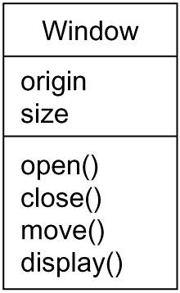
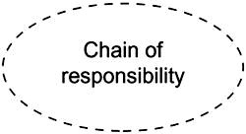
Class Name
Attributes
Figure 2: Interfaces
Operations
Figure 3: Collaborations
Figure 1: Classes

Slide 9
•
use case - a description of set of sequence of actions that a system performs that yields an observable result of value to a particular actor. A use case is used to structure the behavioral things in a model. A use case is realized by a collaboration.
active class - a class whose objects own one or more processes or threads and therefore can initiate control activity. An active class is just like a class except that its objects represent elements whose behavior is concurrent with other elements.
component - a physical and replaceable part of a system that conforms to and provides the realization of a set of interfaces. Represents the physical packaging of otherwise logical elements, such as classes, interfaces, and collaborations.
node - a physical element that exists at run time and represents a computational resource, having at least some memory and, often, processing capability. A set of components may reside on a node and may also migrate from node to node.
•
•
•

Slide 10
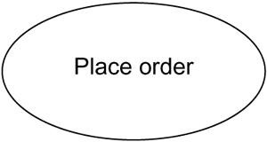
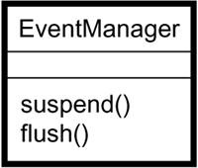
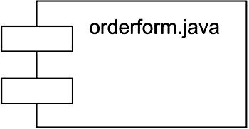
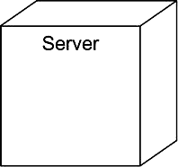
Figure 3: Use Cases
Figure 4: Active Classes
Figure 5: Components
Figure 6: Nodes

Slide 11
Behavioral Things
Behavioral things are the dynamic parts of UML models.
These are the verbs of a model, representing behavior over time and space.
Two primary kinds of behavioral things.
Interaction (exchange of set of messages among a set of objects)(includes message, links, action sequence)
State Machine (specifies the sequences of states an object or an interaction goes through during its lifetime in response to events, together with its responses to those events.)(includes states, transitions, events, activities)
* Shown in the figure 7 and 8

Slide 12
Grouping Things
Grouping things are the organizational parts of UML models. These are the boxes into which a model can be decomposed.
There is one primary kind of grouping.
– Packages(mechanism for organizing elements
into groups)
(a package is purely conceptual
meaning that it exists only at development time)
* Shown in the figure 9

Slide 13
Annotational Things
Annotational things are the explanatory parts of UML models. These are the comments you may apply to describe, illuminate, and remark about any element in a model.
There is one primary kind of annotational things.
– Note (a symbol for rendering constraints and comments attached to an element or a collection of elements)
* Shown in the figure 10

Slide 14
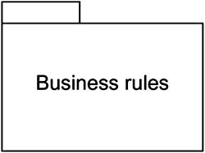

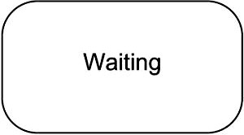
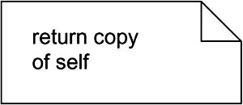
Figure 7: Messages
Figure 9: Packages
Figure 8: States
Figure 10: Notes

Slide 15
Relationships in the UML

Slide 16
Relationships in the UML
•
There are four kinds of relationships in the UML:
1. Dependency (a semantic relationship
between two things in
which a change to one thing may affect the semantics of the other thing)
Association (a structural relationship that describes a set of links, a link being a connection among objects)
Generalization (a specialization / generalization relationship in which objects of the specialized element (the child) are substitutable for objects of the generalized element (the parent))
Realization (a semantic relationship between classifiers, wherein one classifier specifies a contract that another classifier guarantees to carry out) (between interfaces and the classes or components and between use cases and the collaborations)

Slide 17


Relationships in the UML
1. Dependencies: rendered as a
and
dashed line, possibly directed,
occasionally including a label
2. Associations: rendered as a solid line, possibly directed, occasionally including a label, and often containing other adornments, such as multiplicity and role names
Generalizations: rendered as a solid line with a hollow arrowhead pointing to the parent
Realization: rendered as a cross between a generalization and a dependency relationship

Slide 18
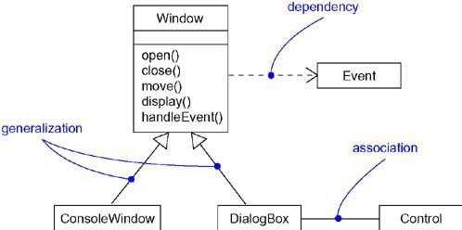
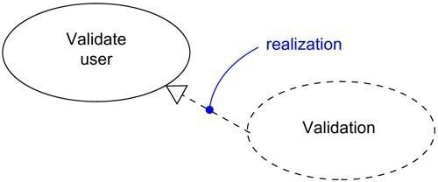
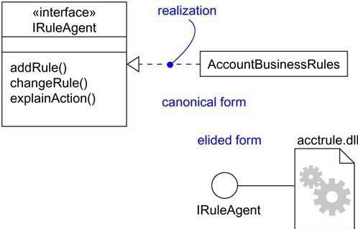

Slide 19
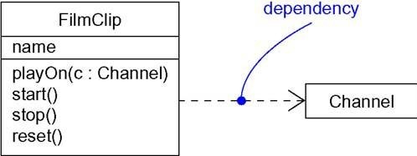
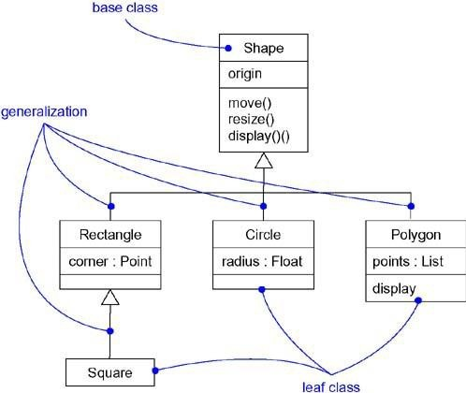
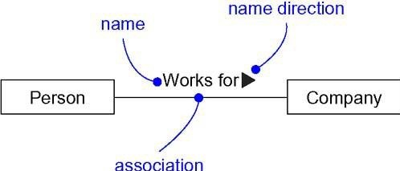

Slide 20
Diagrams in the UML
graphical rendered
presentation of
a set
of elements,
as a connected graph of vertices
(things) and arcs (relationships).
a projection into a system
The same element may appear in all diagrams, only a few diagrams (the most common case), or in no diagrams at all (a very rare case)

Slide 21
Diagrams in the UML
Class diagram
Object diagram
Use case diagram
Sequence diagram
Collaboration diagram
Statechart diagram
Activity diagram
Component diagram
Deployment diagram
Interaction diagrams

Slide 22
1. Class Diagram
•
A class diagram shows a set of classes, interfaces, and collaborations and their relationships.
most common diagram found in modeling object- oriented systems.
address the static design view of a system.
Class diagrams that include active classes address the static process view of a system.
•
•
•

Slide 23
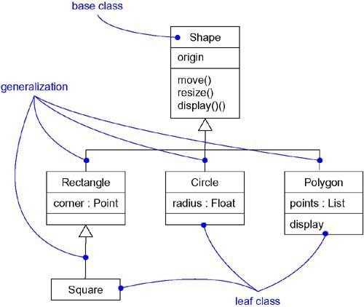

Slide 24
2. Object Diagram
An object diagram shows a set of objects and their relationships.
Object diagrams represent static snapshots of instances of the things found in class diagrams.
address the static design view or static process view of a system as do class diagrams, but from the perspective of real or prototypical cases.

Slide 25
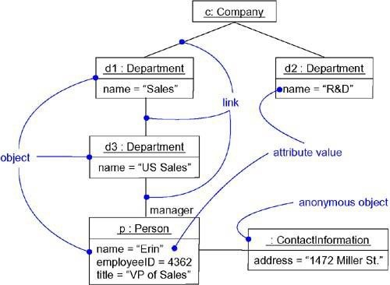

Slide 26
3. Use Case Diagram
A use case diagram shows a set of use cases and actors (a special kind of class) and their
relationships.
address the static use case view of a system.
especially important in organizing and modeling the behaviors of a system.

Slide 27
Interaction Diagrams
Both sequence diagrams and collaboration
diagrams are kinds of interaction diagrams.
Arc shows an interaction, consisting of a set of objects and their relationships, including the messages that may be dispatched among them.
Interaction diagrams address the dynamic view of a system

Slide 28
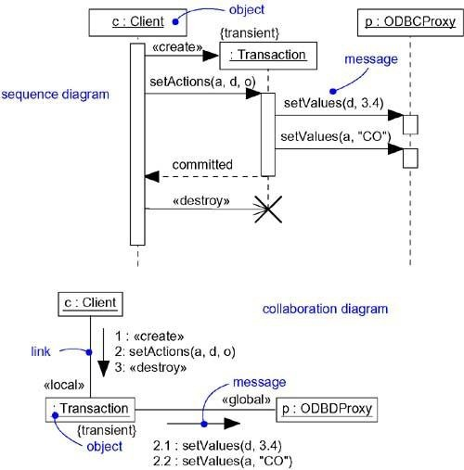

Slide 29
4. Sequence Diagram
A sequence diagram is an interaction diagram that emphasizes the time-ordering of messages.

Slide 30
5. Collaboration Diagram
collaboration diagram is an interaction diagram that emphasizes the structural organization of the objects that send and receive messages.
Note: Sequence diagrams and collaboration diagrams are isomorphic, meaning that you can take one and transform it into the other.

Slide 31
6. Statechart Diagram
•
A statechart diagram shows a state machine,
consisting of states, transitions, events and activities.
Statechart diagrams address the dynamic view of a system.
especially important in modeling the behavior of an interface, class, or collaboration and emphasize the event-ordered behavior of an object, which is especially useful in modeling reactive systems.
•
•

Slide 32
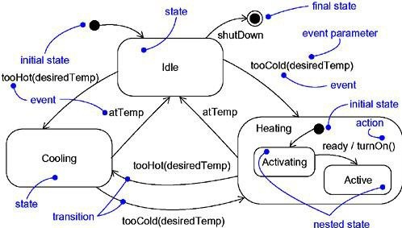

Slide 33
7. Activity Diagram
An activity diagram is a special kind of a statechart diagram that shows the flow from activity to activity within a system.
Activity diagrams address the dynamic view of a system.
They are especially important in modeling the function of a system and emphasize the flow of control among objects

Slide 34
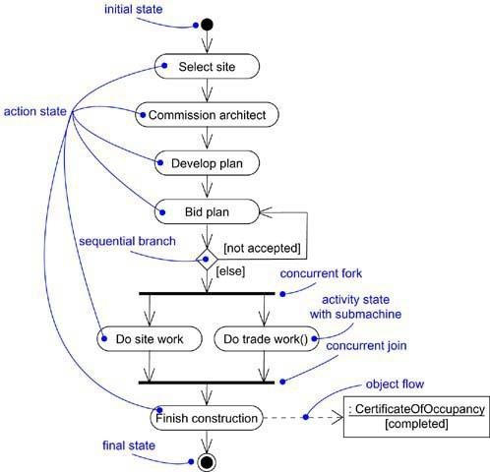

Slide 35
8. Component Diagram
•
A component diagram shows the organizations and dependencies among a set of components.
Component diagrams address the static implementation view of a system.
They are related to class diagrams in that a component typically maps to one or more classes, interfaces, or collaborations.
•
•

Slide 36
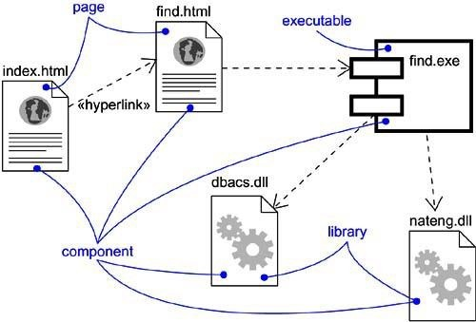

Slide 37
9. Deployment Diagram
•
A deployment diagram shows the configuration of run-time processing nodes and the components that live on them.
Deployment diagrams address the static deployment view of an architecture.
They are related to component diagrams in that a node typically encloses one or more components.
•
•

Slide 38
